Slide 1
Azure VMware Solution Documentation Hub – Master Diagrams

Slide 2
Azure VMware Solution Documentation Hub – Overview section

Slide 3


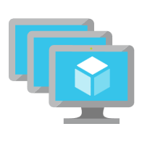
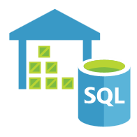
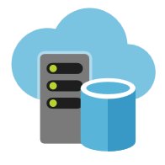





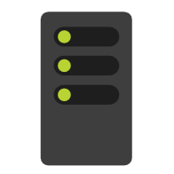
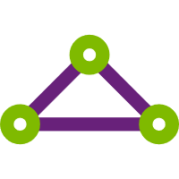

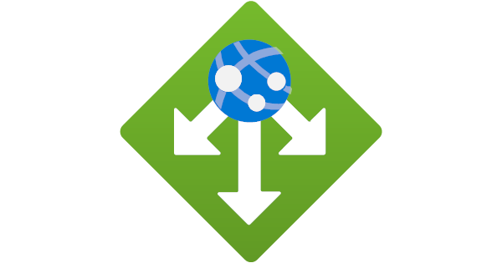






Microsoft Azure
Azure Subscription
Azure Services
Customer On-Premises Environments
Azure VMware Solution
Private Clouds
Azure ExpressRoute
VMware
vCenter Server
VMware NSX
Bare-Metal
ESXi hosts
VMware
vCenter Server
Azure Bare-Metal
ESXi hosts
VMware
vSAN Datastores
Azure Virtual Networks
Image location: https://learn.microsoft.com/en-us/azure/azure-vmware/media/introduction/adjacency-overview-drawing-final.png

Slide 4

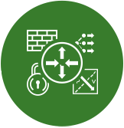
Microsoft Azure
Azure VMware Solution
Private Cloud
Azure ExpressRoute
Dedicated Microsoft
Enterprise Edge (D-MSEE)
Azure Dell
Bare-Metal
ESXi hosts
VMware
vSAN Datastore
VMware
vCenter Server
VMware NSX
Cluster-1 needs three AV36, AV36P, or AV52 nodes in a supported Azure region
VMware NSX
Edges
Azure Network Backbone
AV64 can be used for Clusters 2 to 12
Azure AV64
Bare-Metal
ESXi hosts
Image location: https://learn.microsoft.com/en-us/azure/azure-vmware/media/introduction/av64-mixed-sku-topology.png

Slide 5
Microsoft Azure
Azure VMware Solution
Private Cloud
Fault
Domain 1
Fault
Domain 2
Fault
Domain 3
Fault
Domain 4
Fault
Domain 5
Fault
Domain 6
Fault
Domain 7
Azure ExpressRoute
Azure AV64
Bare-Metal
ESXi host 1
Azure AV64
Bare-Metal
ESXi host 2
Azure AV64
Bare-Metal
ESXi host 3
Azure AV64
Bare-Metal
ESXi host 4
Azure AV64
Bare-Metal
ESXi host 5
Azure AV64
Bare-Metal
ESXi host 6
Azure AV64
Bare-Metal
ESXi host 7
Dedicated Microsoft
Enterprise Edge (D-MSEE)
Azure AV64
Bare-Metal
ESXi host 8
Image location: https://learn.microsoft.com/en-us/azure/azure-vmware/media/introduction/remove-host-scenario-1.png

Slide 6
Microsoft Azure
Azure VMware Solution
Private Cloud
Fault
Domain 1
Fault
Domain 2
Fault
Domain 3
Fault
Domain 4
Fault
Domain 5
Fault
Domain 6
Fault
Domain 7
Azure ExpressRoute
Azure AV64
Bare-Metal
ESXi host 1
Azure AV64
Bare-Metal
ESXi host 2
Azure AV64
Bare-Metal
ESXi host 3
Azure AV64
Bare-Metal
ESXi host 4
Azure AV64
Bare-Metal
ESXi host 5
Azure AV64
Bare-Metal
ESXi host 6
Azure AV64
Bare-Metal
ESXi host 7
Dedicated Microsoft
Enterprise Edge (D-MSEE)
Azure AV64
Bare-Metal
ESXi host 8
Azure AV64
Bare-Metal
ESXi host 9
Azure AV64
Bare-Metal
ESXi host 10
Azure AV64
Bare-Metal
ESXi host 11
Azure AV64
Bare-Metal
ESXi host 12
Azure AV64
Bare-Metal
ESXi host 13
Azure AV64
Bare-Metal
ESXi host 14
Image location: https://learn.microsoft.com/en-us/azure/azure-vmware/media/introduction/remove-host-scenario-2.png

Slide 7
Microsoft Azure
Azure VMware Solution
Private Cloud
Fault
Domain 1
Fault
Domain 2
Fault
Domain 3
Fault
Domain 4
Fault
Domain 5
Fault
Domain 6
Fault
Domain 7
Azure ExpressRoute
Azure AV64
Bare-Metal
ESXi host 1
Azure AV64
Bare-Metal
ESXi host 2
Azure AV64
Bare-Metal
ESXi host 3
Dedicated Microsoft
Enterprise Edge (D-MSEE)
Azure AV64
Bare-Metal
ESXi host 8
Image location: https://learn.microsoft.com/en-us/azure/azure-vmware/media/introduction/remove-host-scenario-3.png

Slide 8
Azure VMware Solution Shared Responsibility Matrix
Physical Infrastructure | Physical Security | Azure Portal | Hardware Failures | ESXi Host/Patching | VMware NSX | VMware vSAN | VMware vCenter Server | VMware HCX/ VMware SRM | Identity Management | Connecting to VNet/Internet | Virtual Machines | Guest OS | Applications | 3rd Party Solutions
Deployment/ Lifecycle
Provider Configuration
Tenant Configuration
Support
Microsoft Responsibility
Customer/Tenant Responsibility
3rd Party Responsibility
Not Applicable
Image location: https://learn.microsoft.com/en-us/azure/azure-vmware/media/introduction/azure-introduction-shared-responsibility-matrix.png

Slide 9
Azure VMware Solution Documentation Hub – Gen 2 section

Slide 10

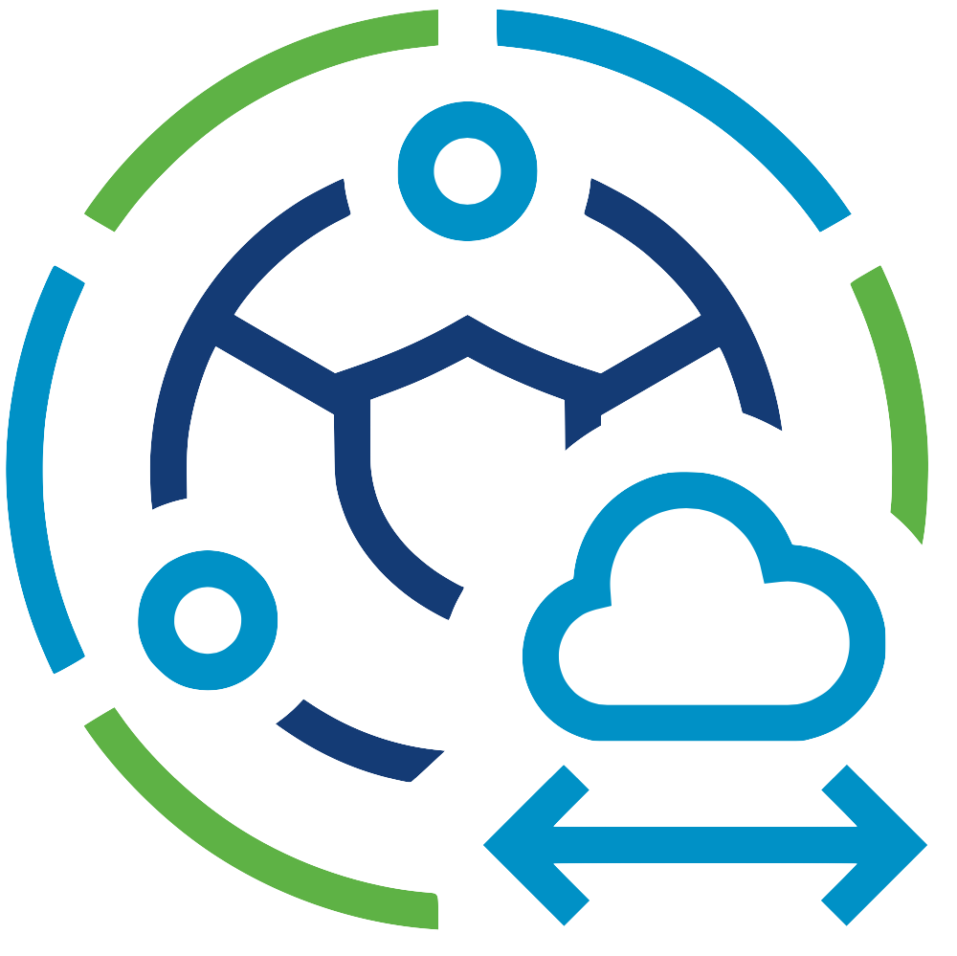

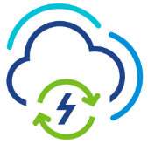
Microsoft Azure
Azure VNet A
VNet Peering
Azure VNet B
Azure VMware Solution
Private Cloud (Gen 2)
Azure Services
Azure ExpressRoute
Gateway
ESXi hosts
VMware
vSAN Datastore
VMware
vCenter Server
VMware NSX
ExpressRoute
Connection
VMware HCX
VMware SRM
Microsoft
Enterprise Edge (MSEE)
VMware NSX
Edges
Azure ExpressRoute
Customer vSphere Environment
(On-Premises, Co-Lo, or Cloud-based)
Customer Edge
Router
Bare-Metal
ESXi hosts
vCenter
Server
vSphere
Datastores
vSphere
Networks
Image location: https://learn.microsoft.com/en-us/azure/azure-vmware/media/native-connectivity/azure-virtual-network-connectivity.png

Slide 11
Microsoft Azure
Azure VNet A
Azure VMware Solution
Private Cloud (Gen 2)
Azure Services
ESXi hosts
VMware
vSAN Datastore
VMware
vCenter Server
VMware NSX
VMware NSX
Edges
VMware HCX
VMware SRM
Image location: https://learn.microsoft.com/en-us/azure/azure-vmware/media/native-connectivity/native-connectivity-private-cloud.png

Slide 12
Microsoft Azure
Azure VNet A
Azure VMware Solution
Private Cloud (Gen 2)
Azure VNet B
VNet Peering
Azure Services
ESXi hosts
VMware
vSAN Datastore
VMware
vCenter Server
VMware NSX
VMware NSX
Edges
VMware HCX
VMware SRM
Image location: https://learn.microsoft.com/en-us/azure/azure-vmware/media/native-connectivity-private-vnet-peering.png

Slide 13
Microsoft Azure
Azure VNet A
Azure VMware Solution
Private Cloud (Gen 2)
Azure ExpressRoute
Gateway
ESXi hosts
VMware
vSAN Datastore
VMware
vCenter Server
VMware NSX
ExpressRoute
Connection
VMware HCX
VMware SRM
Microsoft
Enterprise Edge (MSEE)
VMware NSX
Edges
Azure ExpressRoute
Customer vSphere Environment
(On-Premises, Co-Lo, or Cloud-based)
Customer Edge
Router
Bare-Metal
ESXi hosts
vCenter
Server
vSphere
Datastores
vSphere
Networks
Image location: https://learn.microsoft.com/en-us/azure/azure-vmware/media/native-connectivity/native-connect-on-premises.png

Slide 14

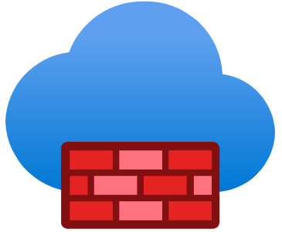
Microsoft Azure
Azure VNet A
Firewall Subnet
Azure VMware Solution
Private Cloud (Gen 2)
Azure
Firewall A
Internet
Azure AV64
Bare-Metal
ESXi hosts
VMware
vSAN Datastore
VMware
vCenter Server
VMware NSX
VNet subnet: esx-lrnsxuplink
Associate following UDR to both subnets:
0.0.0.0/0 NH Type: Virtual Appliance NH IP: Az-FW-IP
VMware NSX
Edges
VNet subnet: esx-lrnsxuplink-1
Image location: https://learn.microsoft.com/en-us/azure/azure-vmware/media/native-connectivity/native-connect-private-cloud-internet.png

Slide 15

Microsoft Azure
Azure VNet A
Azure VNet B
Azure VMware Solution
Private Cloud A (Gen 2)
VNet Peering 1
Azure VMware Solution
Private Cloud B (Gen 2)
VNet Peering
Mesh
Customer Workload
VMs
VNet Peering 2
VNet Peering 3
Customer Workload
VMs
Azure VNet C
Azure VMware Solution
Private Cloud C (Gen 2)
Customer Workload
VMs
Image location: https://learn.microsoft.com/en-us/azure/azure-vmware/media/native-connect-multiple-solutions-on-premises.png

Slide 16
Microsoft Azure
Gen 1
Gen 2
Azure ExpressRoute
Azure ExpressRoute
Gateway
Azure VNet B
Azure VMware Solution
Private Cloud A (Gen 1)
Azure VMware Solution
Private Cloud B (Gen 2)
Dedicated Microsoft
Enterprise Edge
(D-MSEE)
ExpressRoute
Connection
ESXi hosts
VMware
vSAN Datastore
VMware
vCenter Server
VMware NSX
ESXi hosts
VMware
vSAN Datastore
VMware
vCenter Server
VMware NSX
VMware NSX
Edges
VMware HCX
VMware SRM
VMware NSX
Edges
VMware HCX
VMware SRM
Image location: https://learn.microsoft.com/en-us/azure/azure-vmware/media/native-connectivity/native-connect-express-route-previous-edition.png

Slide 17
Azure VMware Solution Documentation Hub – Quickstarts section

Slide 18






Microsoft Azure
Azure ExpressRoute
Dedicated Microsoft
Enterprise Edge (D-MSEE)
Azure VNet
Azure VMware Solution
Private Cloud
Subnet
Azure ExpressRoute
Gateway
Azure Bare-Metal
ESXi hosts
VMware
vSAN Datastore
VMware
vCenter Server
VMware NSX-T
Data Center
Jumpbox
Global Reach
VMware NSX-T
Data Center Edges
VMware HCX
VMware SRM
Microsoft
Enterprise Edge (MSEE)
Azure VNet
Azure Services
Azure ExpressRoute
Gateway
The /22 private network will be used here.
Azure ExpressRoute
Customer vSphere Environment
(On-Prem, Co-Lo, or Cloud-based)
Customer Edge
Router
Bare-Metal
ESXi hosts
vCenter
Server
vSphere
Datastores
vSphere
Networks
Image location: https://learn.microsoft.com/en-us/azure/azure-vmware/media/pre-deployment/management-vmotion-vsan-network-ip-diagram.png

Slide 19
Microsoft Azure
Azure ExpressRoute
Dedicated Microsoft
Enterprise Edge (D-MSEE)
Azure VNet
Azure VMware Solution
Private Cloud
Subnet
Azure ExpressRoute
Gateway
Azure Bare-Metal
ESXi hosts
VMware
vSAN Datastore
VMware
vCenter Server
VMware NSX-T
Data Center
Jumpbox
Global Reach
VMware NSX-T
Data Center Edges
VMware HCX
VMware SRM
Microsoft
Enterprise Edge (MSEE)
Azure VNet
Azure Services
Azure ExpressRoute
Gateway
NSX-T Data Center Edges contain the Network Segments
your workload VMs will connect to.
Azure ExpressRoute
Customer vSphere Environment
(On-Prem, Co-Lo, or Cloud-based)
Customer Edge
Router
Bare-Metal
ESXi hosts
vCenter
Server
vSphere
Datastores
vSphere
Networks
Image location: https://learn.microsoft.com/en-us/azure/azure-vmware/media/pre-deployment/nsx-segment-diagram.png

Slide 20
Microsoft Azure
Azure ExpressRoute
Dedicated Microsoft
Enterprise Edge (D-MSEE)
Azure VNet
Azure VMware Solution
Private Cloud
Subnet
Azure ExpressRoute
Gateway
Azure Bare-Metal
ESXi hosts
VMware
vSAN Datastore
VMware
vCenter Server
VMware NSX-T
Data Center
Jumpbox
Global Reach
VMware NSX-T
Data Center Edges
VMware HCX
VMware SRM
Microsoft
Enterprise Edge (MSEE)
Azure VNet
Azure Services
Azure ExpressRoute
Gateway
Azure ExpressRoute
Customer vSphere Environment
(On-Prem, Co-Lo, or Cloud-based)
The Azure VMware Solution connects to your new
Azure Virtual Network via an Azure ExpressRoute Gateway.
You could also use an existing Azure Virtual Network.
Customer Edge
Router
Bare-Metal
ESXi hosts
vCenter
Server
vSphere
Datastores
vSphere
Networks
Image location: https://learn.microsoft.com/en-us/azure/azure-vmware/media/pre-deployment/azure-vmware-solution-expressroute-diagram.png

Slide 21
Azure VMware Solution Documentation Hub – Tutorials section

Slide 22
Microsoft Azure
Azure ExpressRoute
Dedicated Microsoft
Enterprise Edge (D-MSEE)
Azure VNet
Azure VMware Solution
Private Cloud
Subnet
Azure ExpressRoute
Gateway
Azure Bare-Metal
ESXi hosts
VMware
vSAN Datastore
VMware
vCenter Server
VMware NSX-T
Data Center
Jumpbox
Global Reach
VMware NSX-T
Data Center Edges
VMware HCX
VMware SRM
Microsoft
Enterprise Edge (MSEE)
Azure VNet
Azure Services
Azure ExpressRoute
Gateway
Azure ExpressRoute
Customer vSphere Environment
(On-Prem, Co-Lo, or Cloud-based)
Azure ExpressRoute Global Reach connects your
Azure VMware Solution private cloud to your
customer vSphere environment.
Customer Edge
Router
Bare-Metal
ESXi hosts
vCenter
Server
vSphere
Datastores
vSphere
Networks
Image location: https://learn.microsoft.com/en-us/azure/azure-vmware/media/pre-deployment/azure-vmware-solution-on-premises-diagram.png

Slide 23
Azure VMware Solution Documentation Hub – Cost optimization section

Slide 24
Azure VMware Solution Documentation Hub – Architecture section

Slide 25




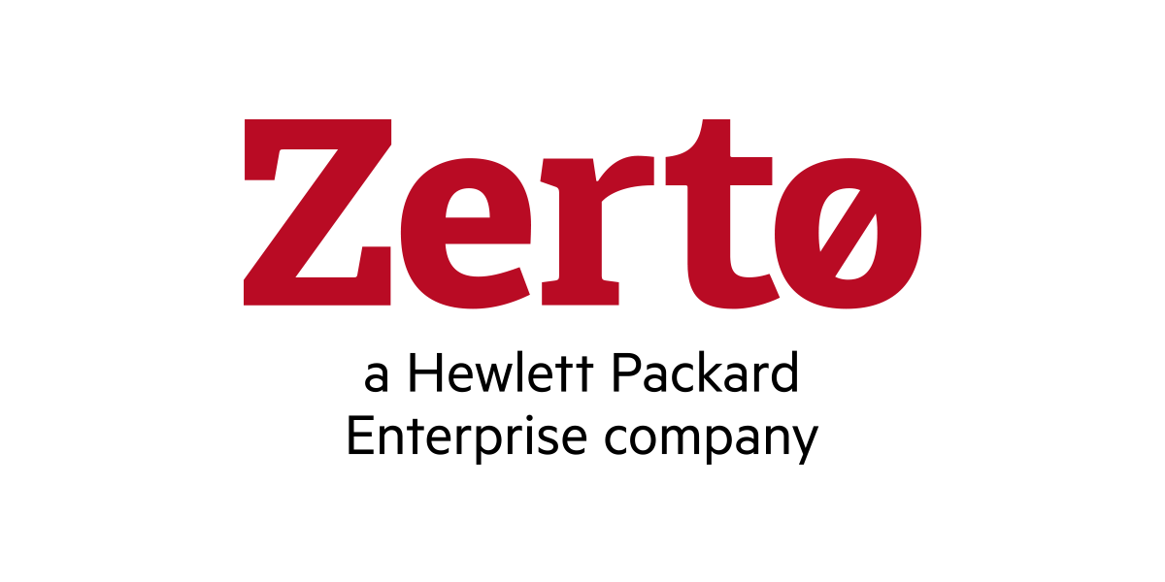


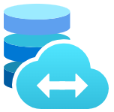
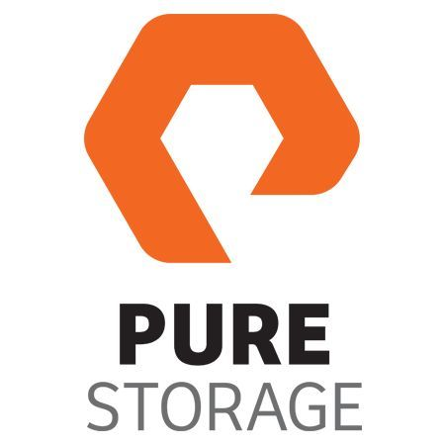
Microsoft Azure
Azure Subscription
Azure ExpressRoute
Dedicated Microsoft
Enterprise Edge
Azure Region
Azure Virtual Network
Azure Virtual WAN
Azure Resource Group
Azure Route Server
Azure Virtual Network
Gateway
Azure VMware Solution
Private Cloud
VMware HCX
VMware SRM
Azure VMware Solution
Resource Cluster
Zerto DR
VMware
vCenter Server
VMware NSX
JetStream
DR
Azure Bare-Metal
ESXi hosts
VMware
vSAN Datastore
Azure Bare-Metal
ESXi hosts
VMware
vSAN Datastore
Azure NetApp Files
Azure Elastic SAN
Pure Cloud Block Store
Image location: https://learn.microsoft.com/en-us/azure/azure-vmware/media/concepts/hosts-clusters-private-clouds-final.png

Slide 26



Microsoft Azure
Dual AZs in an Azure Region
Single Azure Subscription
AZ1 – Preferred Site
AZ2 – Secondary Site
Azure VMware Solution
Private Cloud A
Stretched vSAN Datastore
Azure Bare-Metal
ESXi hosts
VMware
vSAN Datastore
Preferred
Fault Domain
VMware
vCenter Server
VMware NSX
Azure Bare-Metal
ESXi hosts
VMware
vSAN Datastore
Secondary
Fault Domain
VMware NSX
Edge A
VMware HCX
Gold SLA Apps
VMware NSX
Edge B
Gold SLA Apps
Silver SLA Apps
Bronze SLA Apps
Policy-based Synchronous Replication
AZ3 – Witness Site
VMware vSAN
Witness Appliance
Image location: https://learn.microsoft.com/en-us/azure/azure-vmware/media/stretch-clusters/diagram-1-vsan-witness-third-availability-zone.png

Slide 27

Microsoft Azure
Dual AZs in an Azure Region
Single Azure Subscription
AZ1 – Preferred Site
AZ2 – Secondary Site
Azure VMware Solution
Private Cloud A
Stretched vSAN Datastore
Azure Bare-Metal
ESXi hosts
VMware
vSAN Datastore
Preferred
Fault Domain
VMware
vCenter Server
VMware NSX
Azure Bare-Metal
ESXi hosts
VMware
vSAN Datastore
Secondary
Fault Domain
Inter-AZ Network Failure
VMware NSX
Edge A
VMware HCX
Gold SLA Apps
VMware NSX
Edge B
Silver SLA Apps
Bronze SLA Apps
vSphere HA Power-Off
AZ3 – Witness Site
VMware vSAN
Witness Appliance
Image location: https://learn.microsoft.com/en-us/azure/azure-vmware/media/stretch-clusters/diagram-2-secondary-site-power-off-workload.png

Slide 28
Microsoft Azure
Dual AZs in an Azure Region
Single Azure Subscription
AZ1 – Preferred Site
AZ2 – Secondary Site
Azure VMware Solution
Private Cloud A
Stretched vSAN Datastore
vSphere HA Restart
Azure Bare-Metal
ESXi hosts
VMware
vSAN Datastore
Preferred
Fault Domain
VMware
vCenter Server
VMware NSX
Azure Bare-Metal
ESXi hosts
VMware
vSAN Datastore
Secondary
Fault Domain
VMware
vCenter Server
VMware NSX
VMware NSX
Edge A
VMware HCX
Gold SLA Apps
VMware NSX
Edge B
Silver SLA Apps
Bronze SLA Apps
VMware NSX
Edge A
VMware HCX
Gold SLA Apps
Site Failure
AZ3 – Witness Site
VMware vSAN
Witness Appliance
Image location: https://learn.microsoft.com/en-us/azure/azure-vmware/media/stretch-clusters/diagram-3-restart-workload-secondary-site.png

Slide 29
Microsoft Azure
Dual AZs in an Azure Region
Single Azure Subscription
AZ1 – Preferred Site
AZ2 – Secondary Site
Azure VMware Solution
Private Cloud A
Stretched vSAN Datastore
vSphere HA Restart
Azure Bare-Metal
ESXi hosts
VMware
vSAN Datastore
Preferred
Fault Domain
VMware
vCenter Server
VMware NSX
Azure Bare-Metal
ESXi hosts
VMware
vSAN Datastore
Secondary
Fault Domain
VMware
vCenter Server
VMware NSX
VMware NSX
Edge A
VMware HCX
Gold SLA Apps
VMware NSX
Edge B
Silver SLA Apps
Bronze SLA Apps
VMware NSX
Edge A
VMware HCX
Gold SLA Apps
Network Isolation
AZ3 – Witness Site
VMware vSAN
Witness Appliance
Image location: https://learn.microsoft.com/en-us/azure/azure-vmware/media/stretch-clusters/diagram-4-restart-workload-secondary-site.png

Slide 30
Microsoft Azure
Dual AZs in an Azure Region
Single Azure Subscription
AZ1 – Preferred Site
AZ2 – Secondary Site
Azure
ExpressRoute
Azure
ExpressRoute
Azure VMware Solution
Private Cloud A
VMware NSX
Tier-0 Gateway
Azure
Network
VMware NSX
Edge A
Tier-1 Gateway
VMware NSX
Edge B
Azure Bare-Metal
ESXi hosts
VMware
vCenter Server
VMware
HCX
App VM A
Azure Bare-Metal
ESXi hosts
App VM B
Network Segment A
Network Segment B
Image location: https://learn.microsoft.com/en-us/azure/azure-vmware/media/stretch-clusters/diagram-5-normal-traffic-flow.png

Slide 31
Microsoft Azure
Dual AZs in an Azure Region
Single Azure Subscription
AZ1 – Preferred Site
AZ2 – Secondary Site
Azure
ExpressRoute
Azure
ExpressRoute
Azure VMware Solution
Private Cloud A
Azure
Network
Tier-0 Gateway
VMware NSX
VMware NSX
Edge B
Tier-1 Gateway
VMware NSX
Edge A
Azure Bare-Metal
ESXi hosts
Azure Bare-Metal
ESXi hosts
VMware
vCenter Server
VMware
HCX
App VM A
App VM B
Site Failure
Network Segment A
Network Segment B
Image location: https://learn.microsoft.com/en-us/azure/azure-vmware/media/stretch-clusters/diagram-6-site-failure-traffic-flow.png

Slide 32
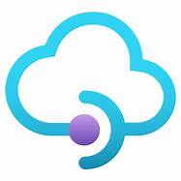
Microsoft Azure
Azure ExpressRoute
Azure ExpressRoute
Gateway
Azure Hub VNet
Azure VMware Solution
Private Cloud
Internet
Dedicated Microsoft
Enterprise Edge
(D-MSEE)
ExpressRoute
Connection
Azure
Firewall
Azure
App GW
Azure Bare-Metal
ESXi hosts
VMware
vSAN Datastore
VMware
vCenter Server
VMware NSX-T
Data Center
Traffic from internet connected users terminate on the Azure API Management public endpoint and is then forwarded to the API backend running in Azure VMware Solution.
Azure
API Management
VMware NSX-T
Data Center Edges
VMware HCX
VMware SRM
Users
Image location: https://learn.microsoft.com/en-us/azure/azure-vmware/media/api-management/api-management-external-deployment.png

Slide 33
Microsoft Azure
Azure ExpressRoute
Azure ExpressRoute
Gateway
Azure Hub VNet
Azure VMware Solution
Private Cloud
Dedicated Microsoft
Enterprise Edge
(D-MSEE)
ExpressRoute
Connection
Azure
Firewall
Azure
App GW
Azure Bare-Metal
ESXi hosts
VMware
vSAN Datastore
VMware
vCenter Server
VMware NSX-T
Data Center
Internet
Global Reach
ExpressRoute
Connection
Azure
API Management
VMware NSX-T
Data Center Edges
VMware HCX
VMware SRM
Microsoft
Enterprise Edge
(MSEE)
Azure ExpressRoute
Customer vSphere Environment
(On-Premises, Co-Lo, or Cloud-based)
Customer Edge
Router
Bare-Metal
ESXi hosts
vCenter
Server
vSphere
Datastores
vSphere
Networks
Users
Image location: https://learn.microsoft.com/en-us/azure/azure-vmware/media/api-management/api-management-internal-deployment.png

Slide 34


Microsoft Azure
Azure ExpressRoute
Azure ExpressRoute
Gateway
Azure Hub VNet
Azure VMware Solution
Private Cloud
Dedicated Microsoft
Enterprise Edge
(D-MSEE)
ExpressRoute
Connection
Azure
Firewall
Azure
App GW
Azure Bare-Metal
ESXi hosts
VMware
vSAN Datastore
VMware
vCenter Server
VMware NSX-T
Data Center
Internet
Global Reach
ExpressRoute
Connection
Jumpbox
Azure
Bastion
VMware NSX-T
Data Center Edges
VMware HCX
VMware SRM
VNet Peering
VNet Peering
Microsoft
Enterprise Edge
(MSEE)
Azure PaaS Spoke VNet
Azure IaaS Spoke VNet
Azure
VMs
Azure SQL Databases
Azure ExpressRoute
Customer vSphere Environment
(On-Premises, Co-Lo, or Cloud-based)
Customer Edge
Router
Bare-Metal
ESXi hosts
vCenter
Server
vSphere
Datastores
vSphere
Networks
Image location: https://learn.microsoft.com/en-us/azure/azure-vmware/media/hub-spoke/azure-vmware-solution-hub-and-spoke-deployment.png

Slide 35
Microsoft Azure
Azure ExpressRoute
Azure ExpressRoute
Gateway
Azure Hub VNet
Azure VMware Solution
Private Cloud
Dedicated Microsoft
Enterprise Edge
(D-MSEE)
ExpressRoute
Connection
Azure
Firewall
Azure
App GW
Azure Bare-Metal
ESXi hosts
VMware
vSAN Datastore
VMware
vCenter Server
VMware NSX-T
Data Center
Internet
Global Reach
ExpressRoute
Connection
Jumpbox
Azure
Bastion
VMware NSX-T
Data Center Edges
VMware HCX
VMware SRM
VNet Peering
VNet Peering
Microsoft
Enterprise Edge
(MSEE)
Azure PaaS Spoke VNet
Azure IaaS Spoke VNet
Azure
VMs
Azure SQL Databases
Azure ExpressRoute
Customer vSphere Environment
(On-Premises, Co-Lo, or Cloud-based)
Customer Edge
Router
Bare-Metal
ESXi hosts
vCenter
Server
vSphere
Datastores
vSphere
Networks
Image location: https://learn.microsoft.com/en-us/azure/azure-vmware/media/hub-spoke/on-premises-azure-vmware-solution-traffic-flow.png

Slide 36
Microsoft Azure
Azure ExpressRoute
Azure ExpressRoute
Gateway
Azure Hub VNet
Azure VMware Solution
Private Cloud
Dedicated Microsoft
Enterprise Edge
(D-MSEE)
ExpressRoute
Connection
Azure
Firewall
Azure
App GW
Azure Bare-Metal
ESXi hosts
VMware
vSAN Datastore
VMware
vCenter Server
VMware NSX-T
Data Center
Internet
Global Reach
ExpressRoute
Connection
Jumpbox
Azure
Bastion
VMware NSX-T
Data Center Edges
VMware HCX
VMware SRM
VNet Peering
VNet Peering
Microsoft
Enterprise Edge
(MSEE)
Azure PaaS Spoke VNet
Azure IaaS Spoke VNet
Azure
VMs
Azure SQL Databases
Azure ExpressRoute
Customer vSphere Environment
(On-Premises, Co-Lo, or Cloud-based)
Customer Edge
Router
Bare-Metal
ESXi hosts
vCenter
Server
vSphere
Datastores
vSphere
Networks
Image location: https://learn.microsoft.com/en-us/azure/azure-vmware/media/hub-spoke/azure-vmware-solution-hub-vnet-traffic-flow.png

Slide 37

Microsoft Azure
Azure VNet
Azure VNet Subnet
Remote
Protocol
SSL
SSL
Users
Azure
Portal
Azure
Bastion
Azure VM
Azure VM
Azure VM
Image location: https://learn.microsoft.com/en-us/azure/azure-vmware/media/hub-spoke/azure-bastion-hub-vnet.png

Slide 38


Microsoft Azure
0.0.0.0/0
Default Route
Azure ExpressRoute
Azure VMware Solution
Private Cloud
Dedicated Microsoft
Enterprise Edge (D-MSEE)
ExpressRoute
Connection
Azure Hub VNet
Azure Spoke VNet
Microsoft
Enterprise Edge (MSEE)
0.0.0.0/0
Default Route
iBGP
eBGP
0.0.0.0/0
VNet
Peering
Azure Route
Server
ExpressRoute
Connection
Azure
VMs
Azure ExpressRoute
Gateway
NVA
Azure ExpressRoute
Customer Data Center
(On-Premises, or Co-Lo)
Customer Edge
Router
Image location: https://learn.microsoft.com/en-us/azure/azure-vmware/media/concepts-network-design/vmware-solution-default.png

Slide 39
Microsoft Azure
Azure ExpressRoute
10.0.0.0/8
Azure VMware Solution
Private Cloud
10.1.0.0/16
Dedicated Microsoft
Enterprise Edge (D-MSEE)
ExpressRoute
Connection
Azure Hub VNet
Azure Spoke VNet
Microsoft
Enterprise Edge (MSEE)
iBGP
eBGP
10.0.0.0/8
VNet
Peering
10.0.0.0/8
Azure Route
Server
ExpressRoute
Connection
Azure
VMs
Azure ExpressRoute
Gateway
NVA
Data Path
Azure ExpressRoute
Customer Data Center
(On-Premises, or Co-Lo)
Customer Edge
Router
10.2.0.0/16
Image location: https://learn.microsoft.com/en-us/azure/azure-vmware/media/concepts-network-design/vmware-solution-to-on-premises-hairpin.png

Slide 40
Microsoft Azure
Azure ExpressRoute
Azure ExpressRoute
Gateway A
Azure Transit VNet
Azure VMware Solution
Private Cloud
iBGP
eBGP
ExpressRoute
Connection
0.0.0.0/0
Default Route
Azure Route
Server
0.0.0.0/0
NVA
(Transit)
Dedicated Microsoft
Enterprise Edge (D-MSEE)
VNet Peering
IPSec/VXLAN + BGP
Microsoft
Enterprise Edge (MSEE)
Azure VMware Solution prefixes
Azure Hub VNet
Azure Spoke VNet
VNet
Peering
iBGP
eBGP
ExpressRoute
Connection
Azure ExpressRoute
Gateway B
Azure Route
Server
NVA
(FW)
Azure
VMs
Azure ExpressRoute
Customer Data Center
(On-Premises, or Co-Lo)
Customer Edge
Router
Image location: https://learn.microsoft.com/en-us/azure/azure-vmware/media/concepts-network-design/vmware-solution-to-on-premises.png

Slide 41
Microsoft Azure
Azure ExpressRoute
Dedicated Microsoft
Enterprise Edge (D-MSEE)
Azure VNet
Azure VMware Solution
Private Cloud
Subnet
Azure ExpressRoute
Gateway
Azure Bare-Metal
ESXi hosts
VMware
vSAN Datastore
VMware
vCenter Server
VMware NSX-T
Data Center
Jumpbox
Global Reach
VMware NSX-T
Data Center Edges
VMware HCX
VMware SRM
Microsoft
Enterprise Edge (MSEE)
Azure VNet
Azure Services
Azure ExpressRoute
Gateway
Image location: https://learn.microsoft.com/en-us/azure/azure-vmware/media/concepts/adjacency-overview-drawing-single.png

Slide 42
Microsoft Azure
Azure ExpressRoute
Dedicated Microsoft
Enterprise Edge (D-MSEE)
Azure VNet
Azure VMware Solution
Private Cloud
Subnet
Azure ExpressRoute
Gateway
Azure Bare-Metal
ESXi hosts
VMware
vSAN Datastore
VMware
vCenter Server
VMware NSX-T
Data Center
Jumpbox
Global Reach
VMware NSX-T
Data Center Edges
VMware HCX
VMware SRM
Microsoft
Enterprise Edge (MSEE)
Azure VNet
Azure Services
Azure ExpressRoute
Gateway
Azure ExpressRoute
Customer vSphere Environment
(On-Premises, Co-Lo, or Cloud-based)
Customer Edge
Router
Bare-Metal
ESXi hosts
vCenter
Server
vSphere
Datastores
vSphere
Networks
Image location: https://learn.microsoft.com/en-us/azure/azure-vmware/media/concepts/adjacency-overview-drawing-double.png

Slide 43


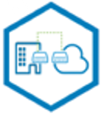
Microsoft Azure
Customer vSphere Environment
(On-Premises, Co-Lo, or Cloud)
Source Environment
Azure VMware Solution
Private Cloud A
Target Environment
Customer Edge
Router
D-MSEE
HCX Service Mesh
D-MSEE
VMware HCX
Connector Appliance
Layer 2 Network Extension
VMware HCX
Manager Appliance
Azure
ExpressRoute
Azure
ExpressRoute
VMware HCX Migration with Layer 2 Network Extension
VMware HCX
IX Appliance
VMware HCX
WO Appliance
VMware HCX
NE Appliance
VMware HCX
NE Appliance
VMware HCX
WO Appliance
VMware HCX
IX Appliance
Gold SLA
Apps
Silver SLA
Apps
Bronze SLA
Apps
Gold SLA
Apps
Silver SLA
Apps
Bronze SLA
Apps
Image location: https://learn.microsoft.com/en-us/azure/azure-vmware/media/concepts/vmware-hcx-migration-concepts.png

Slide 44
Azure VMware Solution Documentation Hub – Private cloud infrastructure section

Slide 45



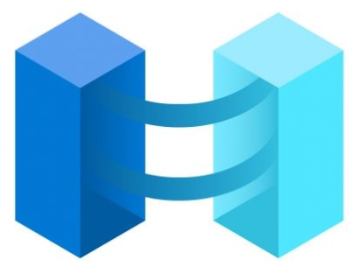
Azure Security Center
Azure Monitor
On-Premises Environment
Gold SLA Apps
Silver SLA Apps
Bronze SLA Apps
Enterprise
Services
Azure Update Manager
Log Analytics Agents
Azure Log Analytics Workspace
Log Analytics Agents
Azure VMware Solution
Private Cloud
Azure Arc
VM Create, Read, Update, Delete and Log Analytics agent Automation
Gold SLA Apps
Silver SLA Apps
Bronze SLA Apps
Enterprise
Services
Image location: https://learn.microsoft.com/en-us/azure/azure-vmware/media/concepts/integrated-azure-monitoring-architecture.png

Slide 46
Move resources

Slide 47
Microsoft Azure
Azure VMware Solution
Private Cloud A
Azure Region A
Source Environment
Azure VMware Solution
Private Cloud B
Azure Region B
Target Environment
D-MSEE
HCX Service Mesh
D-MSEE
VMware HCX
VMware HCX
Azure
ExpressRoute
Global
Reach
Azure
ExpressRoute
Microsoft
Enterprise Edge (MSEE)
Azure ExpressRoute
Customer vSphere Environment
(On-Premises, Co-Lo, or Cloud-based)
Customer Edge
Router
Bare-Metal
ESXi hosts
vCenter
Server
vSphere
Datastores
vSphere
Networks
Image location: https://learn.microsoft.com/en-us/azure/azure-vmware/media/move-across-regions/move-ea-csp-across-regions-2.png

Slide 48
Microsoft Azure
Azure VMware Solution
Private Cloud A
Azure Region A
Source Environment
Azure VMware Solution
Private Cloud B
Azure Region B
Target Environment
D-MSEE
HCX Service Mesh
D-MSEE
VMware HCX
Manager Appliance
Layer 2 Network Extension
VMware HCX
Manager Appliance
Azure
ExpressRoute
Azure
ExpressRoute
Global
Reach
VMware HCX
IX Appliance
VMware HCX
WO Appliance
VMware HCX
NE Appliance
VMware HCX
NE Appliance
VMware HCX
WO Appliance
VMware HCX
IX Appliance
Microsoft
Enterprise Edge (MSEE)
Network Segment 1
Network Segment 1 (Extended)
Gold SLA Apps
Silver SLA Apps
Bronze SLA Apps
Azure ExpressRoute
Customer Edge
Router
Customer
vSphere
Environment
Image location: https://learn.microsoft.com/en-us/azure/azure-vmware/media/move-across-regions/move-ea-csp-across-regions-connectivity-diagram.png

Slide 49
Azure VMware Solution Documentation Hub – Security section

Slide 50
Configure identity

Slide 51
Microsoft Azure
Azure ExpressRoute
Azure ExpressRoute
Gateway
Azure Hub VNet
Azure VMware Solution
Private Cloud
Dedicated Microsoft
Enterprise Edge
(D-MSEE)
ExpressRoute
Connection
Active Directory/
LDAP Server
Azure Bare-Metal
ESXi hosts
VMware
vSAN Datastore
VMware
vCenter Server
VMware NSX
LDAPS connections used for user authentication.
VMware NSX
Edges
VMware HCX
VMware SRM
Image location: https://learn.microsoft.com/en-us/azure/azure-vmware/media/nsxt/azure-vmware-solution-to-ldap-server.png

Slide 52

On-Premises Environment
Azure Sentinel
Gold SLA Apps
Silver SLA Apps
Bronze SLA Apps
Enterprise
Services
Log Analytics Agents
Azure Log Analytics Workspace
Log Analytics Agents
Azure VMware Solution
Private Cloud
Azure Security Center
Gold SLA Apps
Silver SLA Apps
Bronze SLA Apps
Enterprise
Services
Image location: https://learn.microsoft.com/en-us/azure/azure-vmware/media/azure-security-integration/azure-integrated-security-architecture.png

Slide 53



Microsoft Azure
Backend Pool
Azure
App GW
Azure VMs
Front End
IP address
Listener
Rule
Browser
Azure
VM Scale Sets
Azure VMware Solution
VMs
Image location: https://learn.microsoft.com/en-us/azure/azure-vmware/media/application-gateway/app-gateway-protects.png

Slide 54
Microsoft Azure
Azure ExpressRoute
Azure ExpressRoute
Gateway
Azure Hub VNet
Azure VMware Solution
Private Cloud
Internet
Dedicated Microsoft
Enterprise Edge
(D-MSEE)
ExpressRoute
Connection
Azure
Firewall
Azure
App GW
Azure Bare-Metal
ESXi hosts
VMware
vSAN Datastore
VMware
vCenter Server
VMware NSX
Azure
API Management
Traffic from internet connected users terminate on the Azure Application Gateway and is then forwarded to the Web server farm (Backend Pool) running in Azure VMware Solution.
VMware NSX
Edges
VMware HCX
VMware SRM
Users
Gold SLA Apps
Silver SLA Apps
Bronze SLA Apps
Web Server Farm
Image location: https://learn.microsoft.com/en-us/azure/azure-vmware/media/hub-spoke/azure-vmware-solution-second-level-traffic-segmentation.png

Slide 55
Configure customer-managed key encryption at rest

Slide 56
Microsoft Azure
Azure VMware Solution
Private Cloud
Azure Bare-Metal
ESXi hosts
VMware
vSAN Datastore
VMware
vCenter Server
VMware NSX
VMware NSX
Edges
VMware HCX
VMware SRM
Allow Microsoft Trusted Services to transit the Azure Key Vault Firewall
Get/Wrap/Unwrap
Authentication
Azure Key Vault
Microsoft Entra ID
Audit/Event
Logging
Azure Monitor
Image location: https://learn.microsoft.com/en-us/azure/azure-vmware/media/configure-customer-managed-keys/customer-managed-keys-diagram-topology.png

Slide 57
Azure VMware Solution Documentation Hub – Networking section

Slide 58
Connect multiple Azure VMware Solution private clouds in the same region

Slide 59
Microsoft Azure
Single Azure Region
Azure VMware Solution
Private Cloud A
Use AVS Interconnect for highest throughput and lowest latency
between private clouds in same Azure Region
Azure VMware Solution
Private Cloud B
AVS Interconnect 1
AVS Interconnect
Mesh
Customer Workload
VMs
Customer Workload
VMs
AVS Interconnect 2
AVS Interconnect 3
Azure VMware Solution
Private Cloud C
Customer Workload
VMs
Image location: https://learn.microsoft.com/en-us/azure/azure-vmware/media/networking/avs-interconnect.png

Slide 60
NSX Scale and Performance Recommendations for VMware HCX

Slide 61
Microsoft Azure
Dedicated Microsoft
Enterprise Edge
(D-MSEE)
Azure
ExpressRoute
Azure VMware Solution
Private Cloud
NSX Edge-1
Tier-0
Gateway
Tier-0
Gateway
NSX Edge-2
VMware NSX
Tier-1
Gateway
Tier-1
Gateway
TNTXX-HCX-UPLINK
NSX Segments
Image location: https://learn.microsoft.com/en-us/azure/azure-vmware/media/nsxt/default-nsx-topology.png

Slide 62
Microsoft Azure
Dedicated Microsoft
Enterprise Edge
(D-MSEE)
Azure
ExpressRoute
Azure VMware Solution
Private Cloud
NSX Edge-1
Tier-0
Gateway
Tier-0
Gateway
NSX Edge-2
VMware NSX
Tier-1
Gateway
Tier-1
Gateway
New Tier-1
New Tier-1
TNTXX-HCX-UPLINK
HCX-UPLINK2
NSX Segments
Image location: https://learn.microsoft.com/en-us/azure/azure-vmware/media/nsxt/nsx-traffic-flow-additional-tier-1-gateway.png

Slide 63
Configure networking

Slide 64
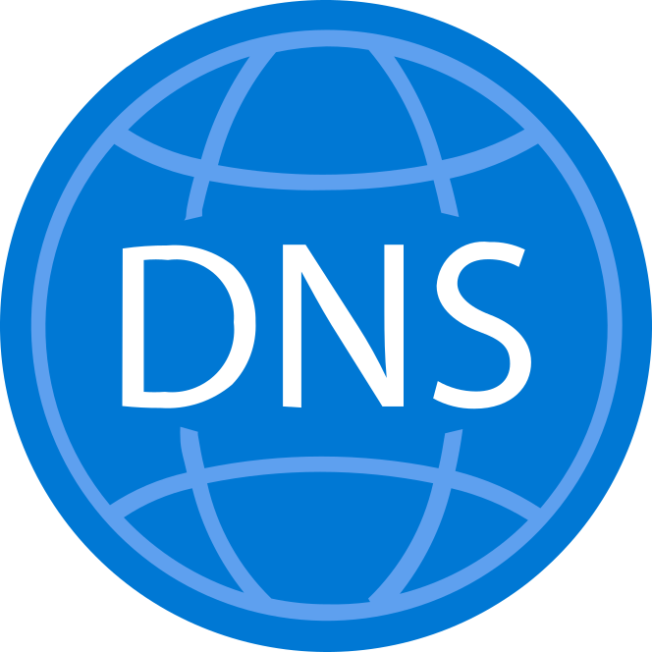
Microsoft Azure
Azure ExpressRoute
Azure ExpressRoute
Gateway
Azure VNet
Azure VMware Solution
Private Cloud
Dedicated Microsoft
Enterprise Edge
(D-MSEE)
ExpressRoute
Connection
contoso.corp
Azure Bare-Metal
ESXi hosts
VMware
vSAN Datastore
VMware
vCenter Server
VMware NSX-T
Data Center
Internet
Global Reach
ExpressRoute
Connection
VMware NSX-T
Data Center Edges
VMware HCX
VMware SRM
NSX-T
DNS
Forwarder
Microsoft
Enterprise Edge
(MSEE)
Azure ExpressRoute
Customer vSphere Environment
(On-Premises, Co-Lo, or Cloud-based)
Customer Edge
Router
Bare-Metal
ESXi hosts
vCenter
Server
vSphere
Datastores
vSphere
Networks
contoso.corp
Image location: https://learn.microsoft.com/en-us/azure/azure-vmware/media/networking/dns/dns-forwarder-diagram.png

Slide 65
Microsoft Azure
Customer vSphere Environment
(On-Premises, Co-Lo, or Cloud)
Source Environment
App VM 1 to App VM 3 traffic flow with L3 Gateway activated On-Premises
Azure VMware Solution
Private Cloud A
Target Environment
Customer Edge
Router
D-MSEE
HCX Service Mesh
D-MSEE
VMware HCX
Connector Appliance
Layer 2 Network Extension
VMware HCX
Manager Appliance
Azure
ExpressRoute
Azure
ExpressRoute
VMware HCX
IX Appliance
VMware HCX
WO Appliance
VMware HCX
NE Appliance
Layer 3 Gateway is switched to Azure VMware Solution
VMware HCX
NE Appliance
VMware HCX
WO Appliance
VMware HCX
IX Appliance
Network Segment 1
Network Segment 1 (Extended)
L3 GW
Disabled
App VM 1 is migrated to
Azure VMware Solution
L3 GW
Active
App VM 1
App VM 1
App VM 1 to App VM 3 traffic flow with L3 Gateway activated in Azure VMware Solution
Network Segment 2
Network Segment 3
App VM 2
App VM 3
Image location: https://learn.microsoft.com/en-us/azure/azure-vmware/media/tutorial-vmware-hcx/hcx-mon-user-case-diagram-1.png

Slide 66
Microsoft Azure
Azure
ExpressRoute
Azure VMware Solution
Private Cloud
Internet/Public
Egress Traffic
VLAN Backed
Management Network
Tier-0 Gateway
VMware NSX-T
Data Center
Tier-1 Gateway
VMware HCX
Manager Appliance
RFC 1918
Egress Traffic
/32 Host Routes via BGP
L3 GW
Active
App VM
VMware HCX
NE Appliance
VMware HCX
WO Appliance
VMware HCX
IX Appliance
Network Segment 1 (Extended)
Policy Route: RFC 1918 (default)
Image location: https://learn.microsoft.com/en-us/azure/azure-vmware/media/tutorial-vmware-hcx/hcx-mon-user-case-diagram-3.png

Slide 67
Microsoft Azure
Azure
ExpressRoute
Azure VMware Solution
Private Cloud
Egress Traffic
VLAN Backed
Management Network
Tier-0 Gateway
VMware NSX-T
Data Center
Tier-1 Gateway
VMware HCX
Manager Appliance
/32 Host Routes via BGP
L3 GW
Active
App VM
VMware HCX
NE Appliance
VMware HCX
WO Appliance
VMware HCX
IX Appliance
Network Segment 1 (Extended)
Policy Route: None Defined
Image location: https://learn.microsoft.com/en-us/azure/azure-vmware/media/tutorial-vmware-hcx/none-hcx-mon-policy-based-routes.png

Slide 68
Microsoft Azure
Azure
ExpressRoute
Azure VMware Solution
Private Cloud
VLAN Backed
Management Network
Tier-0 Gateway
VMware NSX-T
Data Center
Tier-1 Gateway
VMware HCX
Manager Appliance
/32 Host Routes via BGP
Egress Traffic
L3 GW
Active
App VM
VMware HCX
NE Appliance
VMware HCX
WO Appliance
VMware HCX
IX Appliance
Network Segment 1 (Extended)
Policy Route: 0.0.0.0/0
Image location: https://learn.microsoft.com/en-us/azure/azure-vmware/media/tutorial-vmware-hcx/all-traffic-hcx-mon-policy-based-routes.png

Slide 69
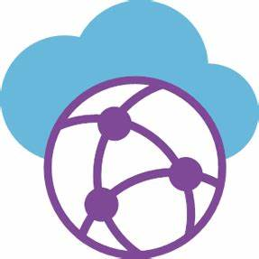
Microsoft Azure
Azure ExpressRoute
Azure ExpressRoute
Gateway
Azure Secured vWAN
Hub
Azure VPN
Gateway
Azure VMware Solution
Private Cloud
Azure Firewall
Site-to-Site VM traffic
Dedicated Microsoft
Enterprise Edge
(D-MSEE)
ExpressRoute
Connection
Azure Bare-Metal
ESXi hosts
VMware
vSAN Datastore
VMware
vCenter Server
VMware NSX-T
Data Center
Internet
VMware NSX-T
Data Center Edges
VMware HCX
VMware SRM
IPSec Tunnel
Customer vSphere Environment
(On-Premises, Co-Lo, or Cloud-based)
Customer Edge
Router
Bare-Metal
ESXi hosts
vCenter
Server
vSphere
Datastores
vSphere
Networks
VPN
Gateway
Image location: https://learn.microsoft.com/en-us/azure/azure-vmware/media/create-ipsec-tunnel/vpn-s2s-tunnel-architecture.png

Slide 70
Configure Internet Connectivity

Slide 71
Microsoft Azure
Internet
Outbound Internet Access Only
Managed SNAT
Azure
ExpressRoute
Azure VMware Solution
Private Cloud
VMware NSX-T
Data Center
Tier-0 Gateway
Tier-1 Gateway
Image location: https://learn.microsoft.com/en-us/azure/azure-vmware/media/public-ip-nsx-edge/architecture-internet-access-avs-public-ip-snat-expanded.png

Slide 72
Microsoft Azure
Internet
Azure PIP range is advertised to Internet with ASN of NSX-T DC Tier-0 Gateway
Traffic flow
Azure VMware Solution
Private Cloud
BGP ASN
VMware NSX-T
Data Center
Tier-0 Gateway
Azure PIP range needs to be consumed within the Tier-1 Gateway or Network Segment
Azure Public IP
Address Range
Tier-1 Gateway
Image location: https://learn.microsoft.com/en-us/azure/azure-vmware/media/public-ip-nsx-edge/architecture-internet-access-avs-public-ip.png

Slide 73
Deploy Traffic Manager to balance workloads

Slide 74
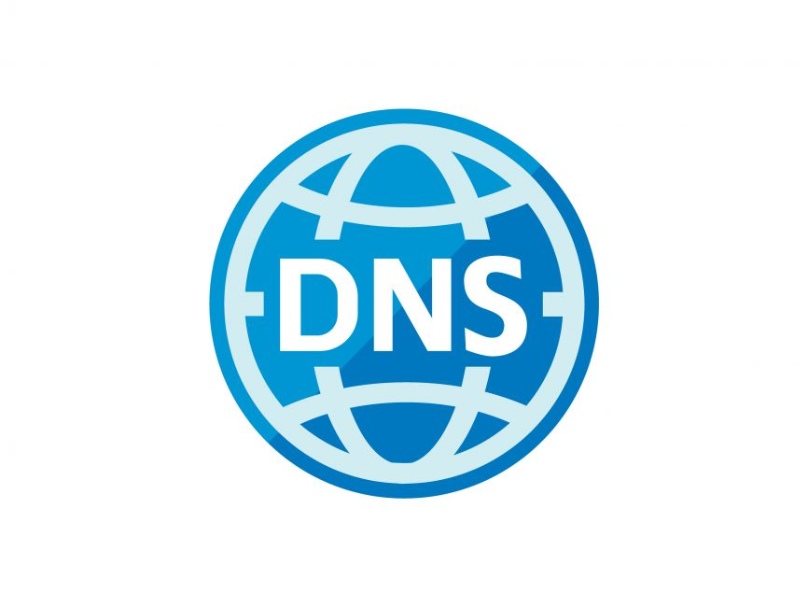
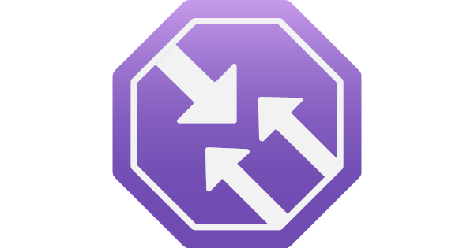
Traffic Manager provides DNS resolution and multi-region traffic control with a latency or geo-proximity traffic policy
Microsoft Azure
Internet
Azure
Traffic Manager
App GW makes load balancing decision within Server Pool
Users
Azure
App GW A
Azure
App GW B
Azure
App GW C
Azure VMware Solution
VMs
Azure VMware Solution
VMs
Azure VMware Solution
VMs
Image location: https://learn.microsoft.com/en-us/azure/azure-vmware/media/traffic-manager/traffic-manager-topology.png

Slide 75
Azure VMware Solution Documentation Hub – Migrate workloads section

Slide 76
Migrate Microsoft SQL Server Always On Cluster to Azure VMware Solution

Slide 77
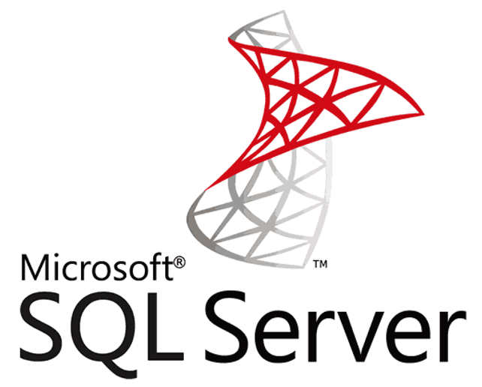
Microsoft Azure
On-Premises vSphere Environment
Azure VMware Solution
Private Cloud
VMware
vCenter Server
Bare-Metal
ESXi hosts
Azure Bare-Metal
ESXi hosts
VMware
vCenter Server
HCX Service Mesh
Registered
Registered
VMware HCX
VMware HCX
Standalone MS-SQL Server
Migrated Standalone MS-SQL Server
HCX vMotion Migration
MS-SQL-1
MS-SQL-1
HCX Layer 2
Network Extension
Image location: https://learn.microsoft.com/en-us/azure/azure-vmware/media/sql-server-hybrid-benefit/migrated-sql-standalone-cluster.png

Slide 78
Microsoft Azure
On-Premises vSphere Environment
Azure VMware Solution
Private Cloud
VMware
vCenter Server
Bare-Metal
ESXi hosts
Azure Bare-Metal
ESXi hosts
VMware
vCenter Server
HCX Service Mesh
Registered
Registered
VMware HCX
VMware HCX
Failover Cluster MS-SQL Server
Migrated Failover Cluster MS-SQL Server
HCX Cold Migration
MS-SQL-1
MS-SQL-2
MS-SQL-1
MS-SQL-2
HCX Layer 2
Network Extension
Image location: https://learn.microsoft.com/en-us/azure/azure-vmware/media/sql-server-hybrid-benefit/migrated-sql-failover-cluster.png

Slide 79
Microsoft Azure
On-Premises vSphere Environment
Azure VMware Solution
Private Cloud
VMware
vCenter Server
Bare-Metal
ESXi hosts
Azure Bare-Metal
ESXi hosts
VMware
vCenter Server
HCX Service Mesh
Registered
Registered
VMware HCX
VMware HCX
MS-SQL Server Always On Cluster
Migrated MS-SQL Server Always On Cluster
HCX vMotion Migration
MS-SQL-1
MS-SQL-2
MS-SQL-1
MS-SQL-2
HCX Layer 2
Network Extension
Image location: https://learn.microsoft.com/en-us/azure/azure-vmware/media/sql-server-hybrid-benefit/sql-always-on-architecture.png

Slide 80
Azure VMware Solution Documentation Hub – Virtual machines section

Slide 81
Configure Windows Server Failover Cluster

Slide 82
Microsoft Azure
Azure ExpressRoute
Azure VMware Solution
Private Cloud
Dedicated Microsoft
Enterprise Edge
(D-MSEE)
Azure Bare-Metal
ESXi hosts
VMware
vSAN Datastore
VMware
vCenter Server
VMware NSX
VMware NSX
Edges
VMware HCX
VMware SRM
WSFC VM 1
WSFC VM 2
Virtual Machine
Disk (VMDK)
with Shared Access
Windows Server Failover Cluster VMs
Image location: https://learn.microsoft.com/en-us/azure/azure-vmware/media/windows-server-failover-cluster/windows-server-failover-architecture.png

Slide 83
Azure VMware Solution Documentation Hub – Virtual Desktop Infrastructure section

Slide 84


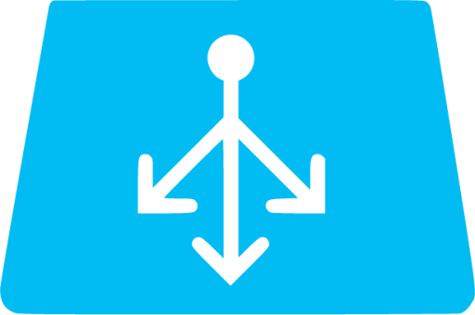


Microsoft Azure
Azure ExpressRoute
Azure ExpressRoute
Gateway
Azure VNet
Azure VMware Solution
Private Cloud 1
Dedicated Microsoft
Enterprise Edge
(D-MSEE)
Load
Balancer
ExpressRoute
Connection
Azure Bare-Metal
ESXi hosts
VMware
vSAN Datastore
VMware
vCenter Server
VMware NSX
VMware Horizon
Connection
Servers
Azure
ExpressRoute
VMware NSX
Edges
Virtual Desktop or Published App with Horizon Agent
Azure
ExpressRoute
VMware Unified
Access Gateways
Azure VMware Solution
Private Cloud 2
Azure VMware Solution
Private Cloud 3
Azure Bare-Metal
ESXi hosts
VMware
vSAN Datastore
VMware
vCenter Server
VMware NSX
Azure Bare-Metal
ESXi hosts
VMware
vSAN Datastore
VMware
vCenter Server
VMware NSX
VMware NSX
Edges
Virtual Desktop or Published App with Horizon Agent
VMware NSX
Edges
Virtual Desktop or Published App with Horizon Agent
Users with VMware Horizon Client
Image location: https://learn.microsoft.com/en-us/azure/azure-vmware/media/vmware-horizon/horizon-pod-deployment-expressroute-connection-fast-path.png

Slide 85




Microsoft Azure
Azure VMware Solution Private Clouds are interconnected using AVS Interconnect or Global Reach.
Azure VMware Solution
Private Cloud 1
VMware Horizon Pod 1
Virtual Desktop or Published App with Horizon Agent
Azure ExpressRoute
Azure VNet
UAG Subnet
VMware Unified
Access Gateways
Azure VMware Solution
Private Cloud 2
Azure ExpressRoute
Azure ExpressRoute
Gateway
Desktop Services Subnet
VMware Horizon
Connection Servers
VMware Horizon
Cloud Connectors
Virtual Desktop or Published App with Horizon Agent
Dedicated Microsoft
Enterprise Edge
(D-MSEE)
Active Directory
Domain Controllers
VMware Horizon
Events Database
VMware Dynamic
Environment Manager
VMware App
Volumes
Azure VMware Solution
Private Cloud 3
Azure ExpressRoute
Virtual Desktop or Published App with Horizon Agent
Image location: https://learn.microsoft.com/en-us/azure/azure-vmware/media/vmware-horizon/single-horizon-pod-azure-vmware-solution.png

Slide 86
Microsoft Azure
Azure VMware Solution Private Clouds are interconnected using AVS Interconnect or Global Reach.
Azure VMware Solution
Private Cloud 1
VMware Horizon Pod 1
Virtual Desktop or Published App with Horizon Agent
Azure ExpressRoute
Azure VNet
Dedicated Microsoft
Enterprise Edge
(D-MSEE)
UAG Subnet
VMware Unified
Access Gateways
Azure VMware Solution
Private Cloud 2
Azure ExpressRoute
Azure ExpressRoute
Gateway
Desktop Services Subnet
VMware Horizon
Connection Servers
VMware Horizon
Cloud Connectors
Virtual Desktop or Published App with Horizon Agent
Active Directory
Domain Controllers
VMware Horizon
Events Database
Global Reach
ExpressRoute
Connection
VMware Dynamic
Environment Manager
VMware App
Volumes
Azure VMware Solution
Private Cloud 3
Azure ExpressRoute
Microsoft
Enterprise Edge
(MSEE)
Global Reach is used to connect the On-Premises environment to each Azure VMware Solution Private Cloud.
Virtual Desktop or Published App with Horizon Agent
Azure ExpressRoute
Customer On-Premises Environment
Virtual Desktop or Published App with Horizon Agent
Image location: https://learn.microsoft.com/en-us/azure/azure-vmware/media/vmware-horizon/connect-corporate-network-azure-virtual-network.png

Slide 87
VMware Horizon Pod 1
Microsoft Azure
Azure VNet 1
Azure VMware Solution
Private Cloud 1
VMware Unified
Access Gateways
ExpressRoute
Connections
UAG Subnet
Virtual Desktop or Published App with Horizon Agent
Azure ExpressRoute
Gateway
Desktop Services Subnet
VMware Horizon
Connection Servers
VMware Horizon
Cloud Connectors
Azure VMware Solution
Private Cloud 2
Active Directory
Domain Controllers
VMware Horizon
Events Database
Virtual Desktop or Published App with Horizon Agent
VMware Dynamic
Environment Manager
VMware App
Volumes
Azure VMware Solution Private Clouds are interconnected using AVS Interconnect or Global Reach.
VMware Horizon Pod 2
VNet Peering
VMware Horizon
Cloud Pod Federation
Azure VMware Solution
Private Cloud 3
Azure VNet 2
UAG Subnet
VMware Unified
Access Gateways
Virtual Desktop or Published App with Horizon Agent
Desktop Services Subnet
Azure VMware Solution
Private Cloud 4
VMware Horizon
Connection Servers
VMware Horizon
Cloud Connectors
Azure ExpressRoute
Gateway
Virtual Desktop or Published App with Horizon Agent
Active Directory
Domain Controllers
VMware Horizon
Events Database
VMware Dynamic
Environment Manager
VMware App
Volumes
Image location: https://learn.microsoft.com/en-us/azure/azure-vmware/media/vmware-horizon/multiple-horizon-pod-azure-vmware-solution.png

Slide 88
Azure VMware Solution Documentation Hub – Storage section

Slide 89
Manage and protect VMs on Azure NetApp Files

Slide 90
Microsoft Azure
Use Azure VNet Gateway Ultra performance SKU or higher to enable FastPath for
highest throughput and lowest latency
Azure
VNet Gateway
Ultra perf. SKU
Azure VMware Solution
Private Cloud
Azure VNet
Azure NetApp Files
Azure Bare-Metal
ESXi hosts
VMware
vSAN Datastore
VMware
vCenter Server
VMware NSX
Dedicated
Microsoft
Enterprise
Edge
(D-MSEE)
Azure
ExpressRoute
Azure
ExpressRoute
ANF volume mounted as Datastore in Azure VMware Solution
VMware NSX
Edges
VMware HCX
VMware SRM
Azure NetApp Files Volume
mounted as an ESXi Datastore
Image location: https://learn.microsoft.com/en-us/azure/azure-vmware/media/attach-netapp-files-to-cloud/architecture-netapp-files-nfs-datastores.png

Slide 91


Microsoft Azure
Azure VMware Solution
Private Cloud
Azure VNet
NFS Protocol
Azure NetApp Files
Azure Bare-Metal
ESXi hosts
VMware
vSAN Datastore
VMware
vCenter Server
VMware NSX
Dedicated
Microsoft
Enterprise
Edge
(D-MSEE)
Azure
ExpressRoute
Azure
ExpressRoute
Network
Interface
Card
Volume
VMware NSX
Edges
VMware HCX
VMware SRM
Gold SLA Apps
Silver SLA Apps
Bronze SLA Apps
VMs connecting to Azure NetApp Files via Guest OS
Image location: https://learn.microsoft.com/en-us/azure/azure-vmware/media/netapp-files/netapp-files-topology.png

Slide 92
Azure VMware Solution Documentation Hub – Backup and recovery section

Slide 93
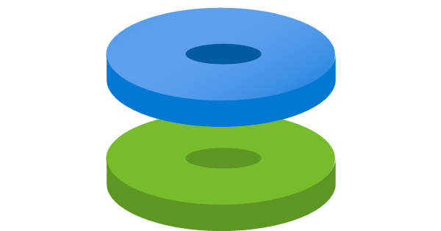
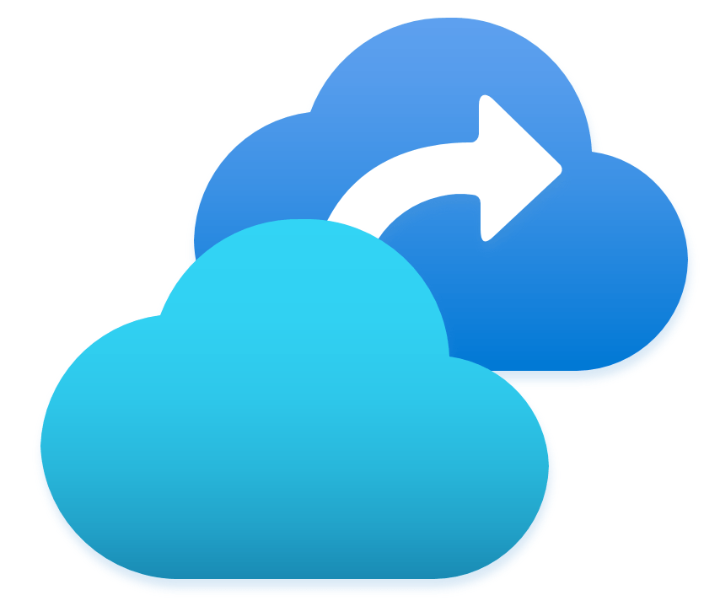
Microsoft Azure
Azure ExpressRoute
Azure ExpressRoute
Gateway
Azure Hub VNet
Azure VMware Solution
Private Cloud
Dedicated Microsoft
Enterprise Edge
(D-MSEE)
ExpressRoute
Connection
Microsoft Azure
Backup Server (MABS)
on Azure VM
with Azure
Managed Disks
Azure Bare-Metal
ESXi hosts
VMware
vSAN Datastore
VMware
vCenter Server
VMware NSX
VMware NSX
Edges
VMware HCX
VMware SRM
Azure Recovery
Services Vault
Gold SLA Apps
Silver SLA Apps
Bronze SLA Apps
Protected VMs
Image location: https://learn.microsoft.com/en-us/azure/azure-vmware/media/azure-vmware-solution-backup/deploy-backup-server-azure-vmware-solution-diagram.png

Slide 94
Azure VMware Solution Documentation Hub – Disaster recovery section

Slide 95
Microsoft Azure
Primary Site vSphere Environment (On-Premises, Co-Lo, or Cloud-based)
Protected Site
Azure VMware Solution
Private Cloud (DR)
Recovery Site
VMware
vCenter Server
Bare-Metal
ESXi hosts
Azure Bare-Metal
ESXi hosts
VMware
vCenter Server
HCX Service Mesh
Registered
Registered
VMware HCX
VMware HCX
HCX DR Replication
Gold SLA Apps
Silver SLA Apps
Bronze SLA Apps
Gold SLA Apps
Silver SLA Apps
Bronze SLA Apps
Image location: https://learn.microsoft.com/en-us/azure/azure-vmware/media/disaster-recovery-virtual-machines/hcx-disaster-recovery-scenario-1-diagram.png

Slide 96
Microsoft Azure
Primary Site vSphere Environment (On-Premises, Co-Lo, or Cloud-based)
Protected Site
Azure VMware Solution
Private Cloud (DR)
Recovery Site
VMware
vCenter Server
Bare-Metal
ESXi hosts
Azure Bare-Metal
ESXi hosts
VMware
vCenter Server
Registered
SRM Site Pair
Registered
Paired
VMware SRM
VMware SRM
Paired
vSphere
Replication
Managed
Managed
VMware vSphere
Replication Manager
VMware vSphere
Replication Server
VMware vSphere
Replication Server
VMware vSphere
Replication Manager
SRM Protection
Groups &
Recovery Plans
Gold SLA Apps
Silver SLA Apps
Bronze SLA Apps
Gold SLA Apps
Silver SLA Apps
Bronze SLA Apps
Image location: https://learn.microsoft.com/en-us/azure/azure-vmware/media/vmware-srm-vsphere-replication/vmware-site-recovery-manager-diagram-on-premises.png

Slide 97
Microsoft Azure
Azure VMware Solution
Private Cloud Primary Site
Azure VMware Solution
Private Cloud (DR)
Recovery Site
VMware
vCenter Server
Azure Bare-Metal
ESXi hosts
Azure Bare-Metal
ESXi hosts
VMware
vCenter Server
Registered
SRM Site Pair
Registered
Paired
VMware SRM
VMware SRM
Paired
vSphere
Replication
Managed
Managed
VMware vSphere
Replication Manager
VMware vSphere
Replication Server
VMware vSphere
Replication Server
VMware vSphere
Replication Manager
SRM Protection
Groups &
Recovery Plans
Gold SLA Apps
Silver SLA Apps
Bronze SLA Apps
Gold SLA Apps
Silver SLA Apps
Bronze SLA Apps
Image location: https://learn.microsoft.com/en-us/azure/azure-vmware/media/vmware-srm-vsphere-replication/vmware-site-recovery-manager-diagram.png

Slide 98
Microsoft Azure
Primary Site vSphere Environment (On-Premises, Co-Lo, or Cloud-based)
Protected Site
Azure VMware Solution
Private Cloud (DR)
Recovery Site
Bare-Metal
ESXi hosts
VMware
vCenter Server
VMware
vCenter Server
Azure Bare-Metal
ESXi hosts
Registered
Zerto Site Pair
Registered
1:1 Paired
1:1 Paired
Managed
Zerto Virtual
Manager
(ZVM)
Zerto Virtual
Manager
(ZVM)
Managed
Zerto
Replication
Zerto Virtual
Replication
Appliances (ZVRAs)
Zerto Virtual
Replication
Appliances (ZVRAs)
Zerto Virtual
Protection Groups
(VPGs)
Gold SLA Apps
Silver SLA Apps
Bronze SLA Apps
Gold SLA Apps
Silver SLA Apps
Bronze SLA Apps
Image location: https://learn.microsoft.com/en-us/azure/azure-vmware/media/zerto-disaster-recovery/zerto-disaster-recovery-scenario-1-diagram.png

Slide 99
Microsoft Azure
Azure VMware Solution
Private Cloud
Protected Site
Azure VMware Solution
Private Cloud (DR)
Recovery Site
Azure Bare-Metal
ESXi hosts
VMware
vCenter Server
VMware
vCenter Server
Azure Bare-Metal
ESXi hosts
Registered
Zerto Site Pair
Registered
1:1 Paired
1:1 Paired
Managed
Zerto Virtual
Manager
(ZVM)
Zerto Virtual
Manager
(ZVM)
Managed
Zerto
Replication
Zerto Virtual
Replication
Appliances (ZVRAs)
Zerto Virtual
Replication
Appliances (ZVRAs)
Zerto Virtual
Protection Groups
(VPGs)
Gold SLA Apps
Silver SLA Apps
Bronze SLA Apps
Gold SLA Apps
Silver SLA Apps
Bronze SLA Apps
Image location: https://learn.microsoft.com/en-us/azure/azure-vmware/media/zerto-disaster-recovery/zerto-disaster-recovery-scenario-2-diagram.png

Slide 100

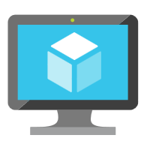
Microsoft Azure
Azure VMware Solution
Private Cloud
Protected Site
Azure vNET
Azure Bare-Metal
ESXi hosts
VMware
vCenter Server
Zerto Cloud
Appliance
(ZCA)
Registered
Zerto Site Pair
1:1 Paired
Managed
Zerto Virtual
Manager
(ZVM)
Zerto
Replication
Azure Blob Storage
Zerto Virtual
Replication
Appliances (ZVRAs)
Zerto
Rehydration to Azure VMs and Azure Managed Disks
Gold SLA Apps
Silver SLA Apps
Bronze SLA Apps
Gold SLA Apps
Silver SLA Apps
Bronze SLA Apps
Image location: https://learn.microsoft.com/en-us/azure/azure-vmware/media/zerto-disaster-recovery/zerto-disaster-recovery-scenario-3-diagram.png

Slide 101
Microsoft Azure
JetStream
Replication
Azure Blob Storage
Primary Site vSphere Environment (On-Prem, Co-Lo, or Cloud-based)
Protected Site
Azure VMware Solution
Private Cloud (DR)
Recovery Site
Bare-Metal
ESXi hosts
VMware
vCenter Server
VMware
vCenter Server
Azure Bare-Metal
ESXi hosts
IO Filter
Registered
Registered
IO Filter
Managed
Managed
JetStream DR
Virtual
Appliance
(DRVA)
JetStream Manager
Virtual
Appliance
(MSA)
JetStream Manager
Virtual
Appliance
(MSA)
JetStream DR
Virtual
Appliance
(DRVA)
JetStream
Protected Domain
Gold SLA Apps
Silver SLA Apps
Bronze SLA Apps
Gold SLA Apps
Silver SLA Apps
Bronze SLA Apps
Image location: https://learn.microsoft.com/en-us/azure/azure-vmware/media/jetstream-disaster-recovery/jetstream-on-premises-to-cloud-diagram.png

Slide 102
Microsoft Azure
JetStream
Replication
Azure Blob Storage
Azure VMware Solution
Private Cloud
Protected Site
Azure VMware Solution
Private Cloud (DR)
Recovery Site
Azure Bare-Metal
ESXi hosts
VMware
vCenter Server
VMware
vCenter Server
Azure Bare-Metal
ESXi hosts
IO Filter
Registered
Registered
IO Filter
Managed
Managed
JetStream DR
Virtual
Appliance
(DRVA)
JetStream Manager
Virtual
Appliance
(MSA)
JetStream Manager
Virtual
Appliance
(MSA)
JetStream DR
Virtual
Appliance
(DRVA)
JetStream
Protected Domain
Gold SLA Apps
Silver SLA Apps
Bronze SLA Apps
Gold SLA Apps
Silver SLA Apps
Bronze SLA Apps
Image location: https://learn.microsoft.com/en-us/azure/azure-vmware/media/jetstream-disaster-recovery/jetstream-cloud-to-cloud-diagram.png

Slide 103
Azure VMware Solution Documentation Hub – Operations and monitoring section

Slide 104
Send VMware syslogs to log management server using Azure Logic Apps

Slide 105
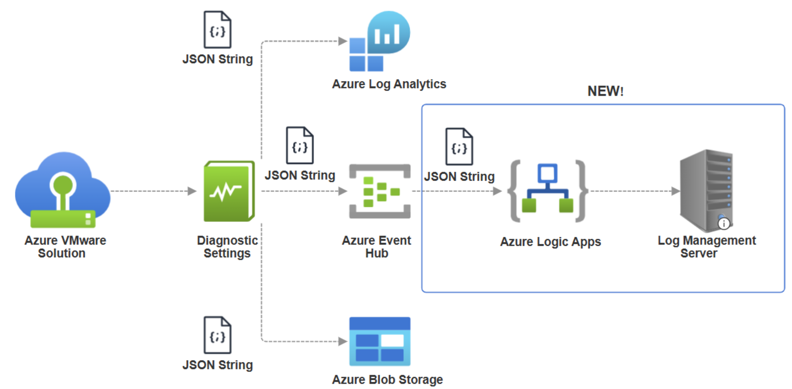
Image location: https://learn.microsoft.com/en-us/azure/azure-vmware/media/logs-to-logic-app/logic-app-arch-diagram.png

Slide 106
Configure VMware Aria Operations

Slide 107

Microsoft Azure
Azure ExpressRoute
Dedicated Microsoft
Enterprise Edge (D-MSEE)
Azure VMware Solution
Private Cloud
Azure Bare-Metal
ESXi hosts
VMware
vSAN Datastore
VMware
vCenter Server
VMware NSX
Global Reach
VMware NSX
Edges
VMware HCX
VMware SRM
Microsoft
Enterprise Edge (MSEE)
VMware Aria Operations is integrated with Azure VMware Solution
Azure ExpressRoute
Customer vSphere Environment
(On-Premises, Co-Lo, or Cloud-based)
Customer Edge
Router
Bare-Metal
ESXi hosts
vCenter
Server
vSphere
Datastores
vSphere
Networks
VMware Aria Operations
Image location: https://learn.microsoft.com/en-us/azure/azure-vmware/media/vrealize-operations-manager/aria-operations-deployment-option-1.png

Slide 108
Azure VMware Solution Documentation Hub – Infrastructure automation and management section

Slide 109
Enable VMware Cloud Director Service with Azure VMware Solution

Slide 110

VMware Cloud Director Service instance
Proxy
Connection
Microsoft Azure
Azure VMware Solution
Private Cloud
VMware
vCenter Server
Azure Bare-Metal
ESXi hosts
VMware NSX
VMware
Cloud Proxy
Organization VDC network
Organization VDC network
NSX Tier-1
Gateway
NSX Tier-1
Gateway
Web VMs
App VMs
DB VMs
Web VMs
App VMs
DB VMs
VMware Cloud Director Tenant A
VMware Cloud Director Tenant B
Image location: https://learn.microsoft.com/en-us/azure/azure-vmware/media/vmware-cds/reference-architecture-diagram.png

Slide 111
Microsoft Azure
Azure VMware Solution
Private Cloud
VMware
vCenter Server
Azure Bare-Metal
ESXi hosts
VMware NSX
VMware
Cloud Proxy
Azure VNet
IPSec Tunnel
Organization VDC network
Azure Services
Azure VPN
Gateway
NSX Tier-1
Gateway
Web VMs
App VMs
DB VMs
VMware Cloud Director Tenant A
Image location: https://learn.microsoft.com/en-us/azure/azure-vmware/media/vmware-cds/site-to-site-vpn-diagram.png

Slide 112
Deploy VMware Cloud Director Availability in Azure VMware Solution

Slide 113


VMware Cloud Director Service instance
Proxy
Connection
Microsoft Azure
Primary Site vSphere Environment
(On-Premises, Co-Lo, or Cloud-based)
Protected Site
Azure VMware Solution
Private Cloud (DR)
Recovery Site
Registered
VMware NSX
VMware Cloud Director (VCD)
VMware
vCenter Server
VMware
vCenter Server
Azure Bare-Metal
ESXi hosts
VMware NSX
Plug-in
Registered
Replication
On-Premises Cloud Director Replication Appliance
VCDA Replication management
Appliance
VCDA Replicator Appliances
VCDA
Tunnel Appliance
Replication
Bare-Metal
ESXi hosts
VMware Cloud Director Availability (VCDA) Cloud Appliances
Tenant Level replication
Gold SLA Apps
Silver SLA Apps
Bronze SLA Apps
Gold SLA Apps
Silver SLA Apps
Bronze SLA Apps
Tenant Virtual data center workloads
Tenant Virtual data center workloads
Image location: https://learn.microsoft.com/en-us/azure/azure-vmware/media/deploy-vmware-cloud-director-availability/vmware-cloud-director-availability-diagram.png

Slide 114
Azure VMware Solution Documentation Hub – Resources section

Slide 115
FAQ

Slide 116
Microsoft Azure
Azure Region 1
Azure Region 2
Traffic Flow 2
No Data Charges
Azure
ExpressRoute
D-MSEE
D-MSEE
Azure
ExpressRoute
Azure VMware Solution
Private Cloud A
Azure VMware Solution
Private Cloud C
Global
Reach
AVS Interconnect 1
Traffic Flow 4
No Data Charges
Traffic Flow 1
No Data Charges
Global
Reach
Azure VMware Solution
Private Cloud C
Global
Reach
Azure
ExpressRoute
Azure VNet A
Azure NetApp Files
MSEE
Azure
VNet Gateway
Traffic Flow 3
Egress Data Charges (Metered Billing Model)
No Data Charges (Unlimited Billing Model)
Azure
ExpressRoute
On-Premises vSphere
Environment
VMware
vCenter Server
Bare-Metal
ESXi hosts
Edge
Router
Image location: https://learn.microsoft.com/en-us/azure/azure-vmware/media/data-transfer-charges.png

